Slide 1
Experiences of a Blended Learning support team
    Date: 2022-01-31
    By: Dion Dresschers (VU Amsterdam)
    Version: 2022-10-24
    License: CC BY-SA 4.0 (or otherwise noted)
    Download: https://edu.nl/wbvnd
School of business
and economics

Slide 2
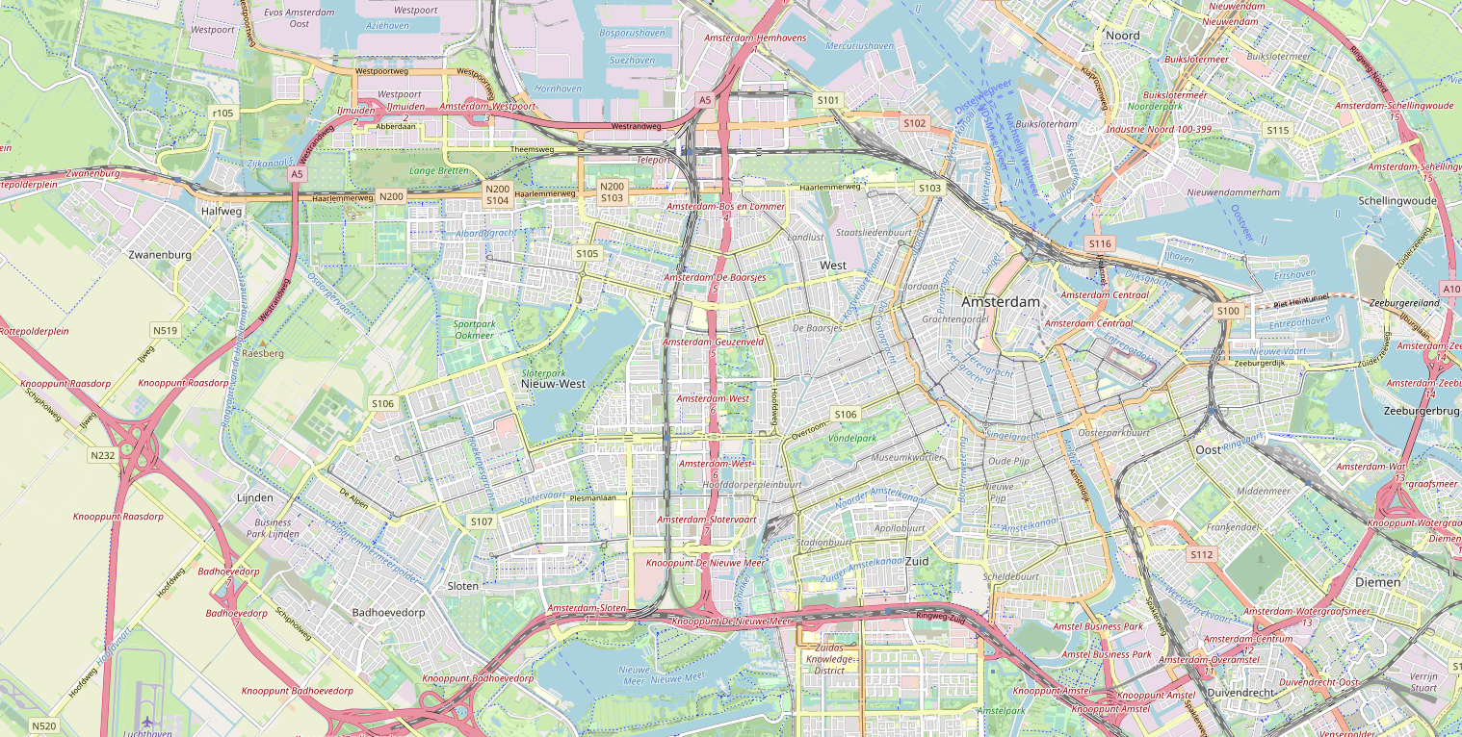
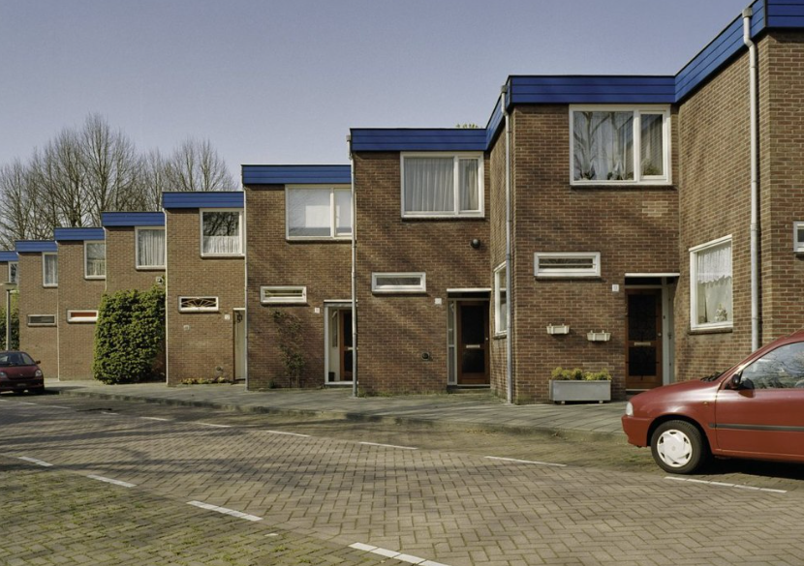

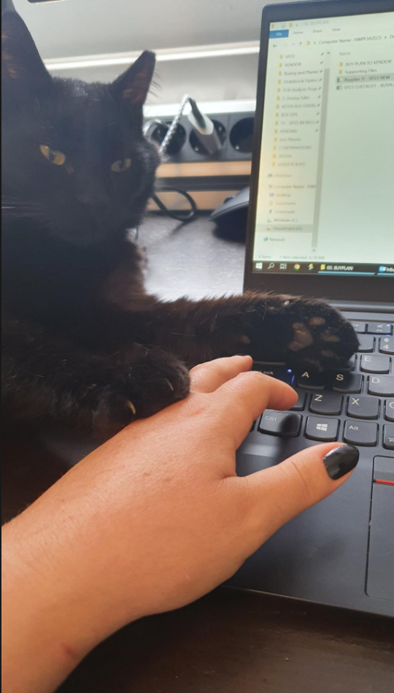
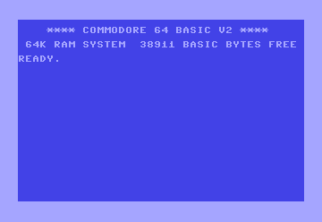
About Me (Dion)
https://www.linkedin.com/in/diondresschers/
1975 – Birth 👶
1990 – Programmed ‘Leren Rekenen’
1991 - Technical College Electro ❌(failed)
1995 - Teacher Physics ❌(failed)
1999 – Worked in IT
2003 – Teacher Physics 👨‍🎓
2003 – Worked in IT
2013 – Worked in IT (Applied University)
2016 – Master Learning and Innovation 👨‍🎓
2018 – Worked in IT 🙄
2021 – Learning Technologist (University) ✅
CC BY-SA 4.0 Rijksdienst voor Cultureel Erfgoed
SCHOOL OF BUSINESS AND ECONOMICS

Slide 3
And what about you!?

Slide 4
Now about our (faculty) Task Force, Action Team and CTL
(…it started around May 2021)

Slide 5
Goal:
To share good things, bad things and remarkable things.
Discuss ‘fundamental’ issues with a partner next to you.
You (optionally) can write stuff down if you want.

Slide 6
Now about our SBE Task Force, Action Team and CTL
(…it started around May 2021)

Slide 7
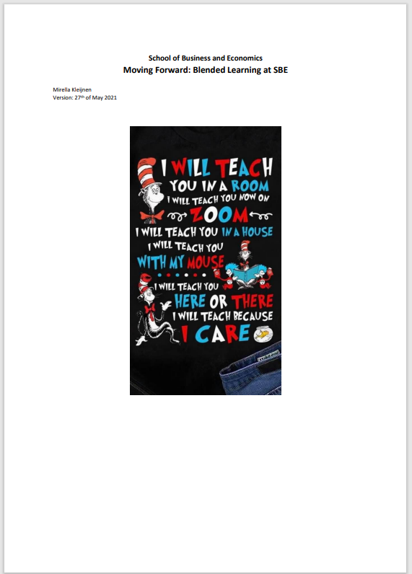
The Policy Document
  My ‘Holy Bible’ written by the SBE Vice-Dean of Education (Mirella Kleijnen).
  https://edu.nl/3438e
SCHOOL OF BUSINESS AND ECONOMICS

Slide 8
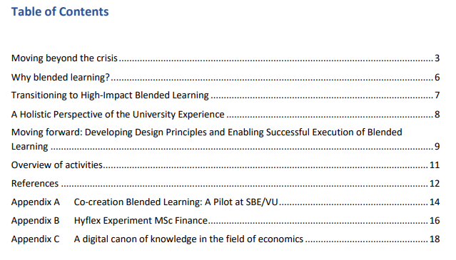
SCHOOL OF BUSINESS AND ECONOMICS

Slide 9
1. How useful is a starting document?
2. Who should write it and what should be in it?

Slide 10
Task Force and Action Team
The task force represents the different stakeholders, but also exists of a number of people relevant to actual delivering supporting the further development of blended learning:
Director of Education
Learn! Academy
Program Director BSc Bedrijfskunde
Coordinator online teaching
Operation Analytics, teacher perspective
Student representative
Innovation coordinator (Teacher)
Learning Technologist 1
Learning Technologist 2
Canvas & Testvision Support
EE Faculty member, teacher perspective
EE Support staff Blended Learning Support
Multimedia Designer
Student Assistant 1
Student Assistant 2
Different teachers (and energy levels)
I don’t want to change too much.
I’m too busy.
My lessons are fine.
It’s too much work.
It’s too risky to change too much.
It will take too much time.
Task Force
Action Team
SCHOOL OF BUSINESS AND ECONOMICS

Slide 11
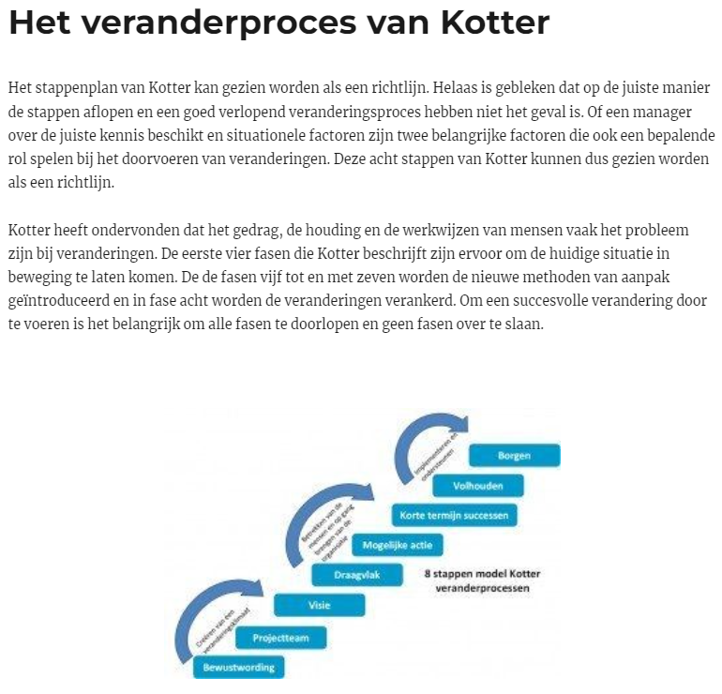
Kotter’s 8-step model of change
  Create Urgency
  Form a powerful coalition
  Create a vision for change
  Communicate the vision
  Empower Action
  Create quick wins
  Build on change
  Make it stick
SCHOOL OF BUSINESS AND ECONOMICS

Slide 12
3. How would you organize a Blended Learning team?
4. What are the short term goals? …and long term?

Slide 13
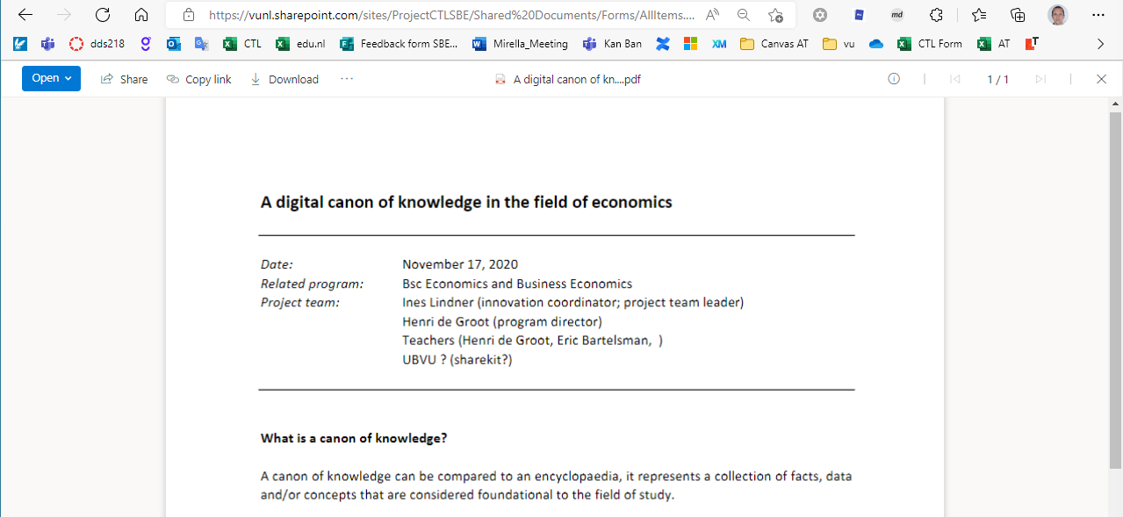
Canon of Knowledge
  ‘Encyclopedia’ of knowledge clips for SBE
  Taxonomy or Lexicon of topics/items
  Information Density (e.g. one concept per clip)
  Length (most sources indicate max. 6 minutes)
  Visibility of Lecturer (!?)
  Produced by SBE versus external sources
  Open Access (Goal)
SCHOOL OF BUSINESS AND ECONOMICS

Slide 14
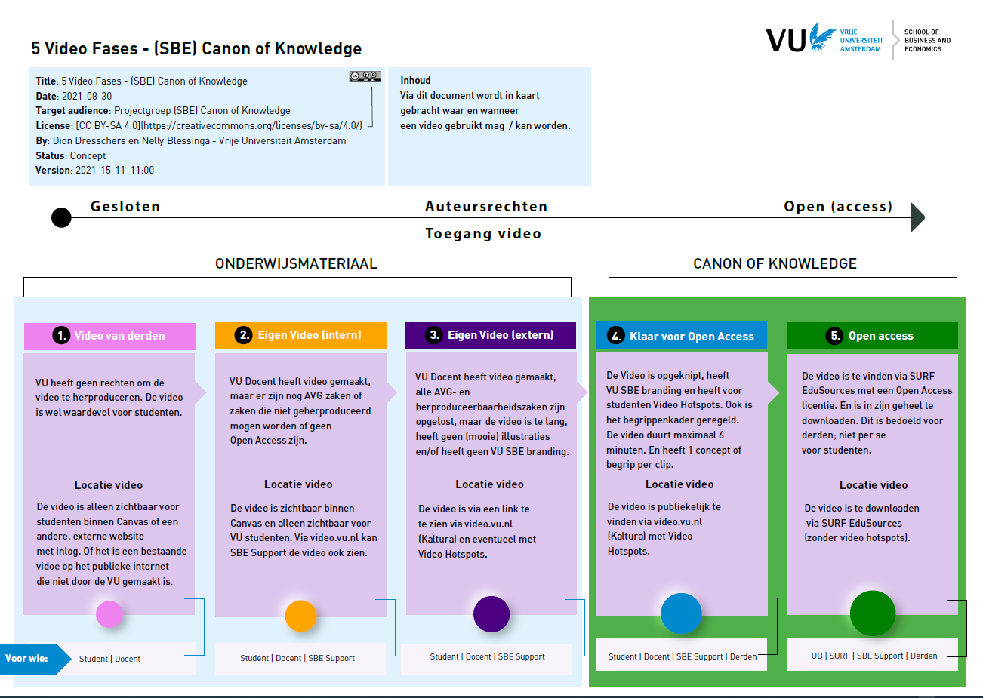
Reason that Canon didn’t happen (yet)
  Project was too ambitious…
  Taxonomy only is too big (and was not consistent)
  Would take more than 5 years to accomplish
  Existing selected videos were too long, had too many subjects, referred to other videos, and lacked consistency
  Key teachers didn’t have enough time (hint: make use of Student Assistants)
  Faculty support were not economists (hint: make use of Student Assistants)
  Copyright and Open Access (complex)
SCHOOL OF BUSINESS AND ECONOMICS

Slide 15
5. What were the good parts of the Canon project?
6. What could/should we have done better?

Slide 16
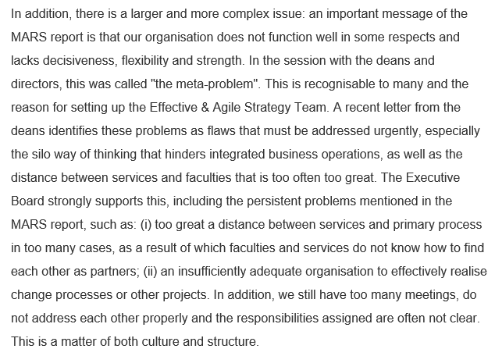
VU Executive board
‘the meta-problem’
  ‘Encyclopedia’ of knowledge clips for SBE
  Taxonomy or Lexicon of topics/items
  Information Density (e.g. one concept per clip)
  Length (most sources indicate max. 6 minutes)
  Visibility of Lecturer (!?)
  Produced by SBE versus external sources
  Open Access (Goal)
SCHOOL OF BUSINESS AND ECONOMICS

Slide 17
Waterfall
Plan
Design
Reason that Canon didn’t happen (yet)
  Project was too ambitious…
  Taxonomy only is too big (and was not consistent)
  Would take more than 5 years to accomplish
  Existing selected videos were too long, had too many subjects, referred to other videos, and lacked consistency
  Key teachers didn’t have enough time (hint: make use of Student Assistants)
  Faculty support were not economists (hint: make use of Student Assistants)
  Copyright and Open Access (complex)
Build
Maintain
Agile
SCHOOL OF BUSINESS AND ECONOMICS

Slide 18
7. Would you prefer Agile or Waterfall method?
8. How big is the gap between service and workfloor?

Slide 19
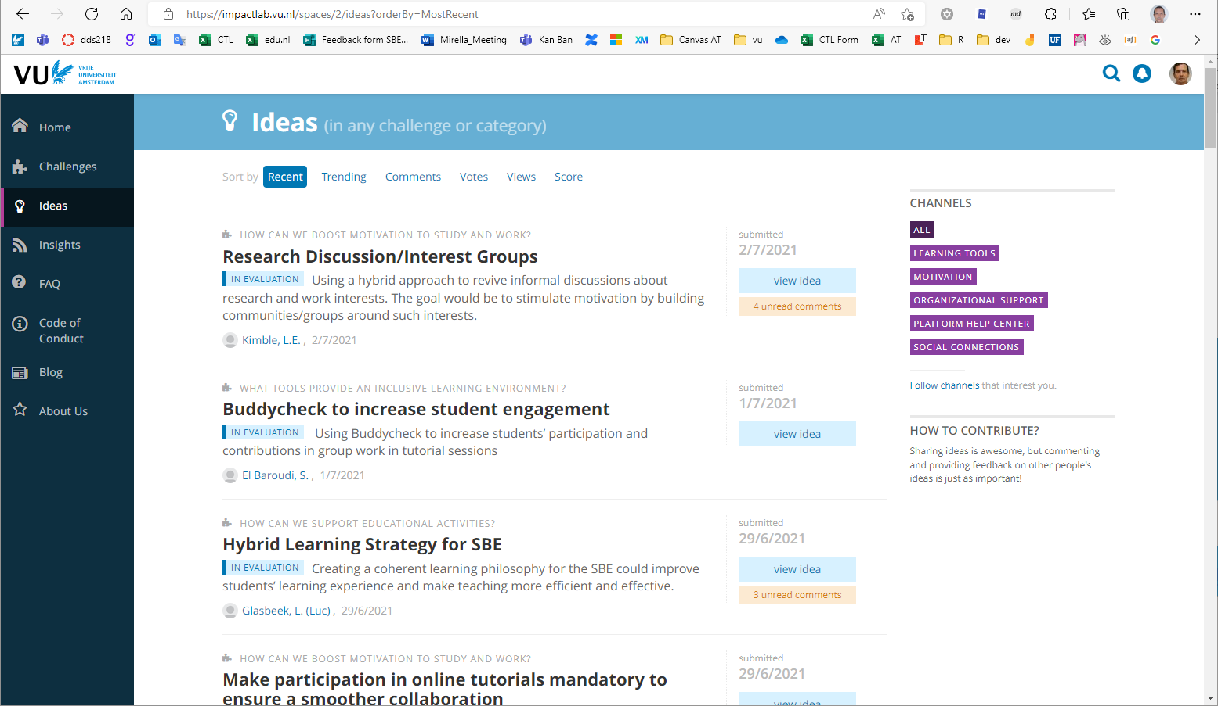
ImpactLab (grassroots)
  “A grassroots movement is one that uses the people in a given district, region or community as the basis for a political or economic movement.”
  By the people (bottom-up)
  All SBE
  All Students, Teachers, Staff, VU
  Idea selection
  Support team
  Wikipedia (2022-10-22)
SCHOOL OF BUSINESS AND ECONOMICS

Slide 20
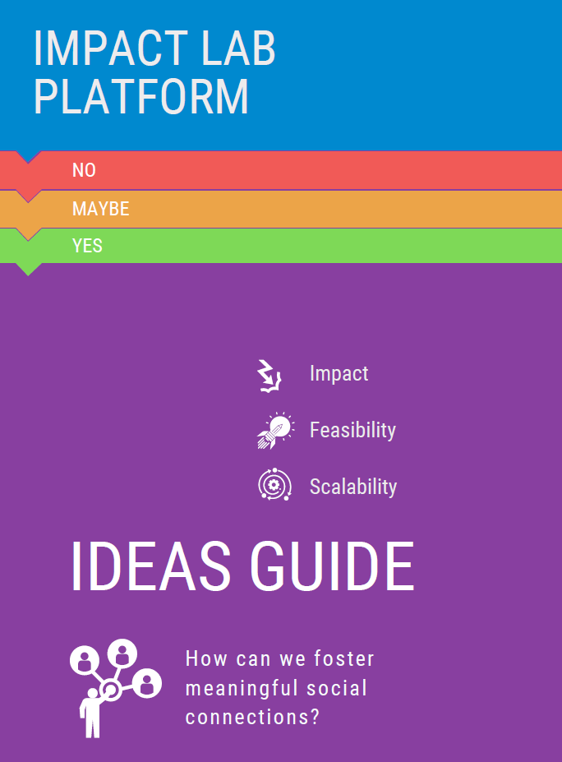
  https://impactlab.vu.nl
  https://edu.nl/7hbwa
  Some ‘winning’ (supported) ideas
  Canvas LMS SBE Template
  Student Advisory Board
  Illustrating Economic Models
  Onboarding New Teachers
  Knowledge Clips
SCHOOL OF BUSINESS AND ECONOMICS

Slide 21
9. How would you get bottom-up ideas
10. How can you support this top-down

Slide 22
Top down
(management makes decision)
Is there policy and decision making, is this needed?
  Who makes the decisions?
  It it the management?
  It is the people at the work floor?
  Or is it both!?
  Who makes policy?
Bottom up
(work floor initiates changes)
SCHOOL OF BUSINESS AND ECONOMICS

Slide 23
Executive
Board
University
Program
Director
Decision Making
  Who is in charge!?
  And will people listen to the person in charge!?
Central
Supports
Your Manager
The Government
Money
providers
The Teacher
Students
(the customers)
Faculty Dean of Education
You ?
SCHOOL OF BUSINESS AND ECONOMICS

Slide 24
11. Who has the authority to create policy at your place?
12. When does policy help, and when not?

Slide 25

Different teachers (and energy levels)
I don’t want to change too much.
I’m too busy.
My lessons are fine.
It’s too much work.
It’s too risky to change too much.
It will take too much time.
SCHOOL OF BUSINESS AND ECONOMICS

Slide 26
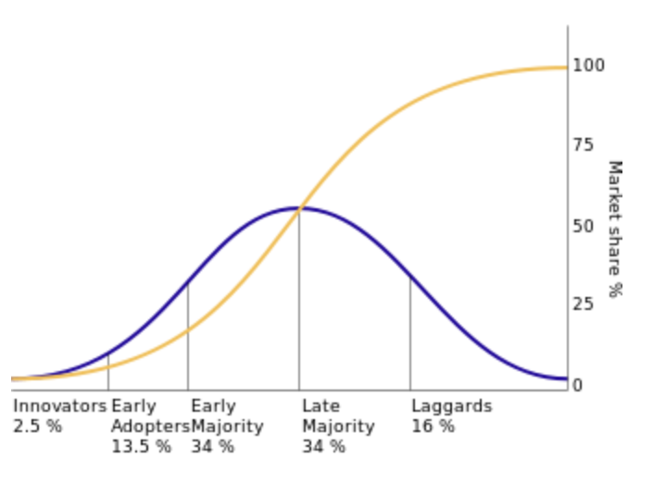
Rogers innovation curve
Different types of teachers (and energy levels)
  Some teachers are innovators.
  Some teachers are open for (good) change.
  Some teachers are too busy (or tired).
  Some teachers don’t want to change.
SCHOOL OF BUSINESS AND ECONOMICS

Slide 27
13. On which group of people would you focus?
14. How would you deal with innovators and laggards?

Slide 28
Central: VU NT&L
  Network for Teaching & Learning.
  Helpdesk
  Program Manager (innovator)
  Pop-Up Studio (video studio)
  Audio & Video guy
  Can connect innovators at faculties
SCHOOL OF BUSINESS AND ECONOMICS

Slide 29
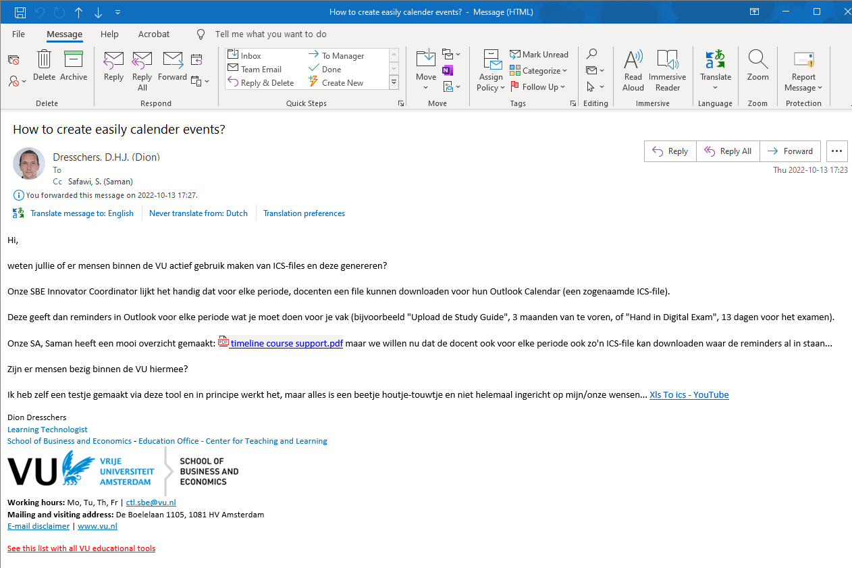
They were very good!!!
  Quick useful replies…
  Or forwarded mail to people that could help
SCHOOL OF BUSINESS AND ECONOMICS

Slide 30
15. What central support can you expect?
16. How to work together with central and faculties?

Slide 31
Tools
  Zoom (video calls)
  Canvas (LMS)
  TestVision (Exams)
  R-Exams (randomized questions)
  FeedbackFruits
  Kaltura (interactive video’s)
  Microsoft Teams (collaborative)
  Annotate Pro (one-click feedback)
  Mentimeter (interactive polls)
SCHOOL OF BUSINESS AND ECONOMICS

Slide 32
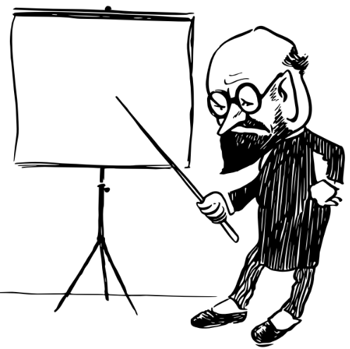
Didactics
  Flipped Classroom
  Team Based Learning
  Direct Feedback
  Gamification
  Peer Feedback
  Group work
  Discussion
  Peer tutoring (experts)
SCHOOL OF BUSINESS AND ECONOMICS

Slide 33
17. Why are Didactics more important than Tools?
18. When are Tools more important than Didactics?

Slide 34
Tools
  How you place looks, says something about the culture…
  And the way if it’s open to innovate
The Smell of a Place…
- Professor Sumantra Ghoshal
SCHOOL OF BUSINESS AND ECONOMICS

Slide 35
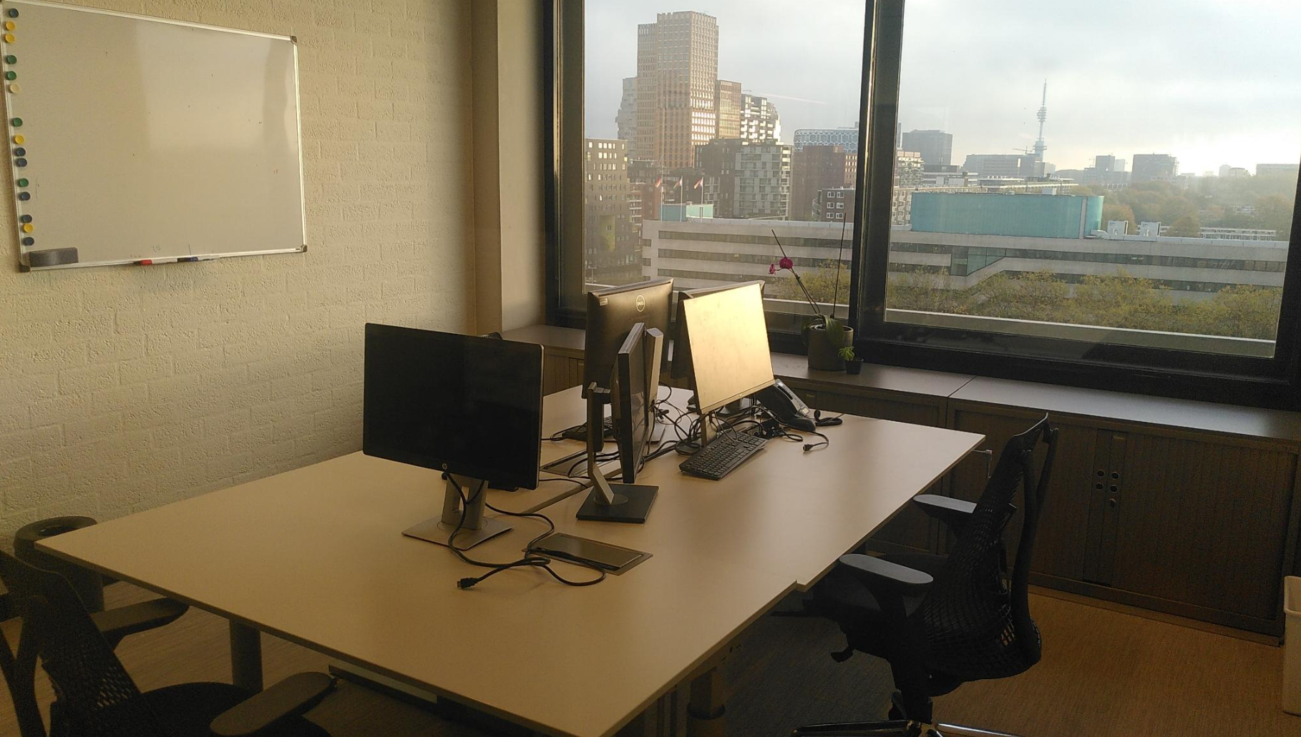
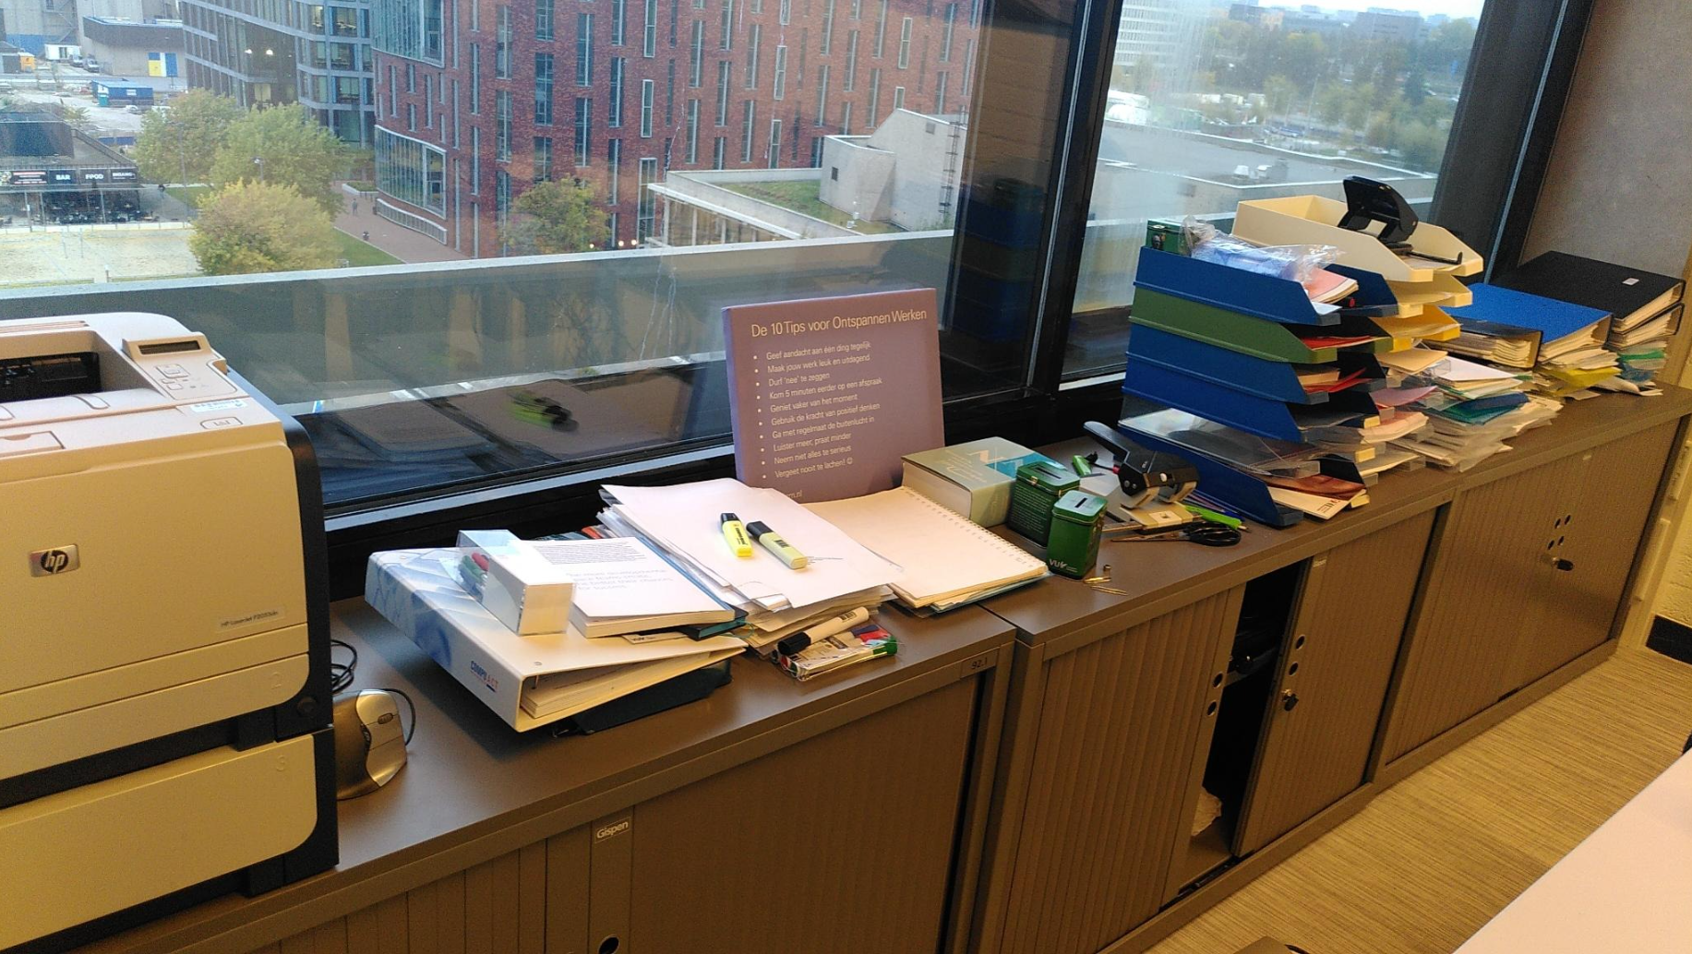
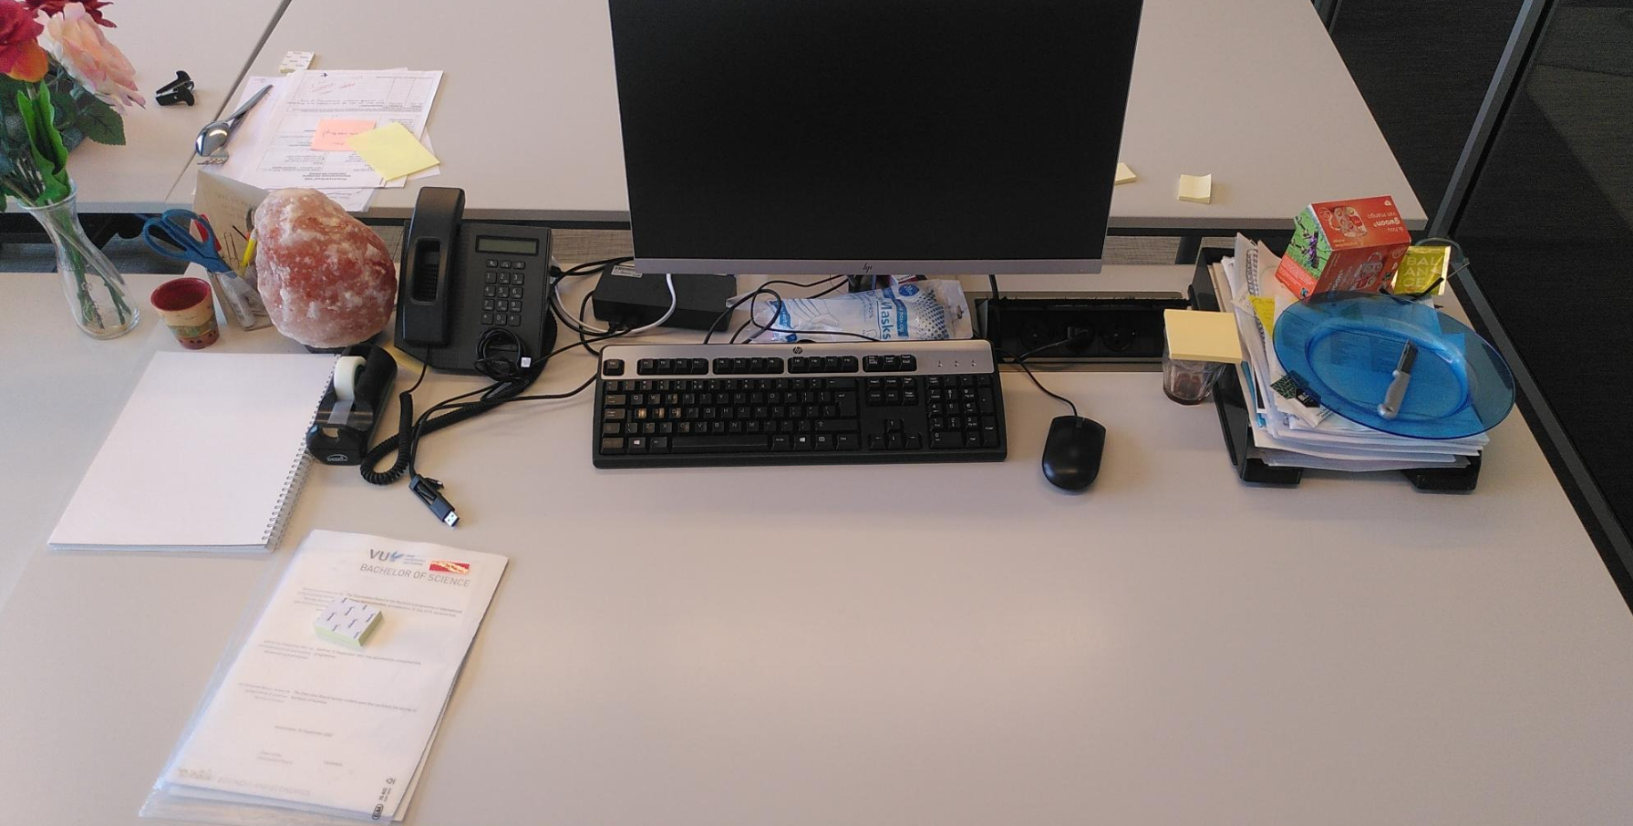
SCHOOL OF BUSINESS AND ECONOMICS

Slide 36
19. How does your work(place) smell?
20. Should/could you change something about your place?

Slide 37
My conclusion:
We learn as we go.
Making mistakes is part of the learning process.
We (all) try our best.
We make mistakes.
We improve as we go.
Celebrate successes! (also for exposure)

Slide 38

School of business
And economics
Thank you!

Slide 39
School of business
And economics
Questions !?

